Slide 1
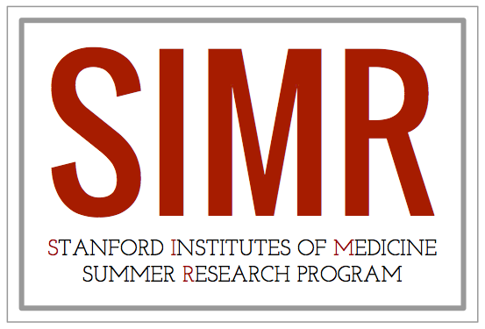

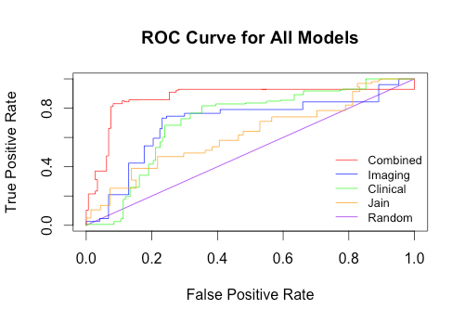
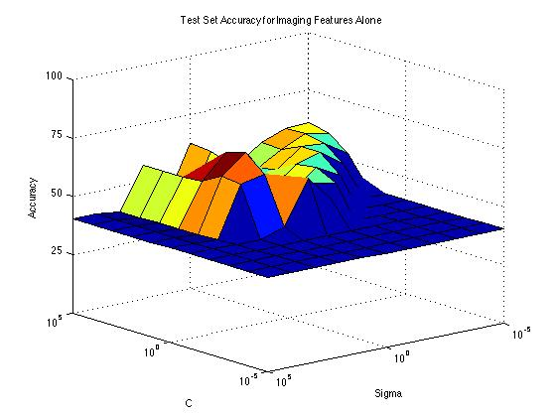
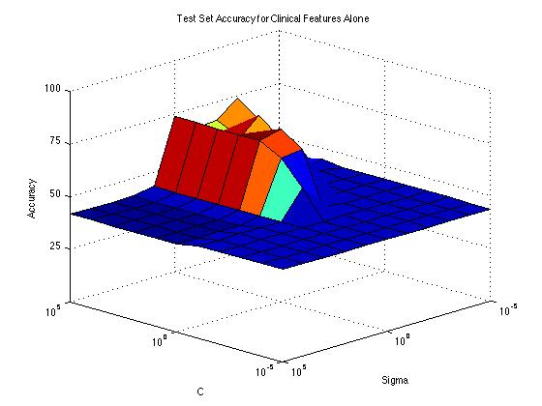
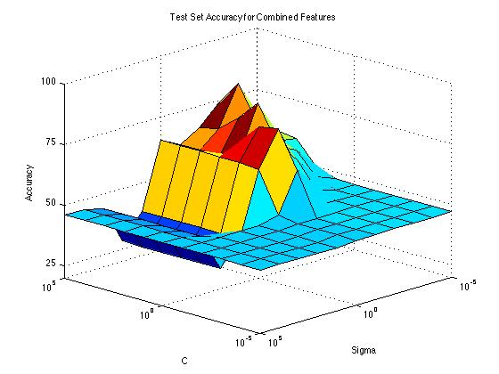



Glioblastoma Patient Survival Prediction Using Texture in Perfusion Imaging
Hugh Zhang, Tiffany Liu, Adrien Depeursinge, Achal Achrol, Daniel Rubin
Department of Radiology at Stanford University
Abstract
Introduction
Results
Limitations
Glioblastoma is one of the deadliest primary brain cancers in adults, responsible for 17% of all brain cancers and having a two year survival rate of only 30%. Despite multimodal therapy, overall survival remains poor.
Our project seeks to build a computational model to predict patient survival. Using the Cancer Genome Atlas dataset, we obtained dynamic susceptibility contrast (DSC) T2* perfusion MR images of each patient’s brains. As tumors rely heavily on blood supply to grow, we hypothesized that our perfusion images, which measure blood flow in the brain, would be indicative of patient survival. In addition, since glioblastoma is well known to be composed of many different types of cells, texture features were specifically focused on to measure tumor heterogeneity. Patients who survived longer than the median cutoff line of 15 months were placed into the high survival group, while others were placed into the low survival group.
Our results indicate that imaging features individually correctly stratified around 70% of patients into groups of low or high survival. Models using only clinical features fared similarly, earning an accuracy of around 75%. Models combining the two features were able to correctly stratify around 85% of patients.
Thus, we conclude that perfusion imaging features are useful in predicting glioblastoma patient survival and that combining both clinical and perfusion imaging features have promising performance in predicting patient survival.
Glioblastoma is a form of brain cancer that infects glial cells, which provide nutrients and support to neurons in the brain. Glial cells have access to a large supply of blood, causing them to be highly malignant and spread rapidly in a patient’s brain. The tumor itself is usually composed of a heterogeneous mix of cell types as well as a central necrotic region of decomposing dead tissue. Thus, Glioblastoma is often difficult to treat; some cells in the tumor may respond well to one type of treatment, while others may be resistant. Glioblastoma treatment often combines several approaches including surgical removal of the tumor as well as chemotherapy and radiation. Even so, median survival is only around fourteen to fifteen months.
Attempts have been made to predict glioblastoma patient survival through genetic analysis, managing to correctly stratify around 75% of patients into low and high survival groups (Bonato). Other researchers have also attempted to use imaging statistics from perfusion images to predict survival (Jain).
Since our data set is fairly small (only thirty patients), in the future we plan to validate our results on a larger independent data set.
Conclusion
We confirmed our hypothesis that texture features of perfusion images have high potential to be used as a biomarker for patient survival. We also validated our hypothesis that combining clinical and imaging features increased the accuracy better than either one of them alone.
 | Test Accuracy | Standard Deviation
Combined | 84.23% | 0.6893%
Imaging | 74.23% | 0.7674%
Clinical | 75.13% | 0.8152%
Figure 5. The ROC curve for all models. Red curve shows both clinical and imaging features and has significantly better accuracy. Blue and green curves show imaging and clinical features respectively. Orange curve shows basic imaging features that prior researchers (Jain) to predict survival. The purple line represents a model no better than a random guess.
Methods
Obtain perfusion images, clinical information, death time, and tumor region of interests (ROI) for each patient (239 image slices for 30 patients)
Extract imaging features, including mean, max, basic contrast (sum of squared differences between each pixel and 4 neighborhood), Gray Level Co-Occurence Matrix (GLCM) and Riesz energies in contrast enhancing lesion of tumor (CEL) as well as the convex area which was an estimate of the tumor microenvironment.
We had more features than patients, so we performed feature selection. Each feature was trained by itself and verified using cross validation.
The best clinical and imaging features were then selected and used in our final model.
Accuracy was calculated by training on 27 patients and testing on 3 patients (10% of data)
Procedure was repeated 1000 times and averaged to produce accuracy rate.
Hypothesis
Since tumor heterogeneity is a prominent feature in glioblastoma, we hypothesized that texture features in perfusion images of glioblastoma patients would be indicative of survival. In addition, we propose these perfusion imaging texture features will be able to supplement clinical features and produce a diagnostic model that will outperform models using only clinical or imaging features alone.
Figures 6, 7 and 8. Surface plots showing test set performance on a support vector machine (SVM) training using imaging features (figure 3), clinical features (figure 4), and both combined (figure 5) for varying SVM parameters of C and sigma which control overfitting.
Acknowledgements
We would like to thank the Stanford Institute of Medical Research (SIMR) for organizing and facilitating this opportunity.
We would also like to thank Dr. Lex Mitchell, Dr. Joshua Loya, Dr. Scott Rodriguez, Dr. Abdullah Feroze, Dr. Erick Westbroek, Prof. Kristen Yeom, Prof. Griffith Harsh for their contributions to this project
References
Figure 1. Perfusion map of a glioblastoma patient with the tumor area marked in white
http://www.abta.org/brain-tumor-information/types-of-tumors/glioblastoma.html
http://emedicine.medscape.com/article/283252-overview
http://www.ncbi.nlm.nih.gov/pubmed/23238158
http://digitalcommons.library.tmc.edu/utgsbs_dissertations/24/
http://www.ncbi.nlm.nih.gov/pmc/articles/PMC3890712/
Figure 2. Radiologist drawn mask of the tumor
Figure 3. Convex hull of the tumor
Figure 4. Approximate tumor microenvironment (inside convex hull but outside tumor mask)

